Slide 1

BIG DATA ANALYTICS
project presentation
Unique, optimal investment strategies for user-specified parameters
By “Big Data Big Dreams”
Ariq Bintang
Luca Gewehr
Marco Hafid

Slide 2

Coming up...
Background
Introduction
Research question
Data
Analysis
Results
Looking forward

Slide 3





Background
Unclear investment expectations.
Ineffective, costly, inaccessible portfolio management.
Investment strategy teams
Broad risk profile
Traditional
investment solutions
Investor
Portfolio manager
Economic research teams
Financial advisor
Middle-office teams
Notes:
After several years of experience in asset management, investment products and banking, including as a private banker myself, coupled with a passion for personal finance, I discovered how much we can improve upon current industry standards.
Present-day portfolio management still relies to a large extent on manual processes and human judgment, entailing various suboptimalities that render such services to be costly (due to human involvement in many aspects of the investment process), inaccessible (due to high fees, many people cannot access personalized financial advice and portfolio management), ineffective (as investment outcomes may not align with the exact financial goals, investment objectives and risk tolerance of investors) and unclear (what the potential outcomes of a given investment strategy are).
Overall, the pain points associated with present-day portfolio management services underscore the potential of a data-driven approach that leverage current technological capabilities applied to large datasets. To this end, we aim to develop such a constrained portfolio optimization model that determines the optimal investment strategy (asset allocation and rebalancing), in a dynamic way, given any combination of input parameters provided by the user (desired investment outcomes, liquidity requirements and risk constraints).
A key inefficiency is that investors are still being offered traditional investment solutions that also do not capture an investor’s unique goals.
Tailor-made, data-driven models could support the transition towards financial services that are less costly, more accessible, more effective and more clear for investors. This is what motivates us to develop strategies that align perfectly with their client's objectives.

Slide 4
Coming up...
Background
Introduction
Research question
Data
Analysis
Results
Scaling & Cloud Deployment

Slide 5
Introduction (1/2)
Objective | Determine the unique, optimal investment strategies for user-specified parameters.
In support | We consider a range of sub-questions.
Ideation | Which financial instruments would be most relevant? Exclude individual assets, given survivorship bias and hindsight bias. Focus on complementary indices of equities, bonds and commodities. Which indices to include in our investment universe? Brainstormed a longlist of 30+ indices.
Data | Price data of selected indices and currency pairs: Refinitiv Eikon, Wharton (WRDS), Yahoo Finance, Bloomberg Terminal. Swiss inflation data: World Bank. CHF money market rates, and spot interest rates on Swiss bonds: Swiss National Bank.

Slide 6
Introduction (2/2)
Methodology | Data preprocessing: Data cleaning, integration and transformation. Data preparation (feature engineering). Derive unique optimal investment strategies for user-specified parameters: Apply (machine learning) algorithms to the relevant dataset. Balance model performance and computational efficiency.
Final result | A reliable tool for decision-making in investment management.

Slide 7
Coming up...
Background
Introduction
Research question
Data
Analysis
Results
Scaling & Cloud Deployment

Slide 8


Research question
What is the unique optimal investment strategy that corresponds exactly to a given user-specified set of investment parameters?
Sub-questions:
Identifying the most relevant investment parameters.
Choosing the appropriate securities to be considered.
Defining and balancing criteria for model accuracy and computational efficiency.
Determining restrictions to possible combinations of securities.
Developing a method to determine an optimal investment strategy.
Identifying the optimal estimation method and corresponding specification
Validating the robustness of the optimal investment strategy.
Considering the impact of inflation and foreign exchange movements.
Evaluating the theoretical underpinnings and assumptions of the optimization model.
Notes:
The main research question is: "What is the unique optimal investment strategy that corresponds exactly to a given user-specified set of investment parameters?" To provide a comprehensive answer, we delve into a set of sub-questions that contribute to the understanding of the factors influencing the choice of optimal investment strategy.
The sub-questions include considerations such as:
Identifying the most relevant investment parameters that determine the optimal corresponding investment strategy. These parameters could be desired investment objectives, risk constraints, time horizon, future deposits/withdrawals, ESG criteria, asset class restrictions, and geographic restrictions, among others.
Choosing the appropriate securities to be considered for the investment universe.
Defining the desired criteria for model accuracy and computational efficiency and finding the balance between these two factors.
Determining the optimal approach to restricting the possible combinations of securities, ensuring the balance between model accuracy and computational efficiency.
Developing a method to determine an optimal investment strategy by comparing equal-length portfolio return series of each candidate strategy. This process would incorporate measures such as maximum drawdown, drawdown length, and conditional VaR.
Identifying the optimal estimation method and corresponding specification for determining the optimal investment strategy.
Validating the robustness and statistical reliability of the optimal investment strategy.
Considering the impact of inflation and foreign exchange movements when determining the optimal investment strategy.
Evaluating the theoretical underpinnings and assumptions of the optimization model.
Identifying potential drawbacks and limitations of the model when applied to real-life investments and finding ways to address or mitigate these issues.

Slide 9
Coming up...
Background
Introduction
Research question
Data
Analysis
Results
Scaling & Cloud Deployment

Slide 10


Data Data sources and data collection
Leveraging data from multiple sources: sources that are reliable and comprehensive, thus well-suited for our research objectives.
File name (raw data) | Data source | Description | Date range (frequency) | File size
Bloomberg_Terminal-spreadsheet_builder.xlsx | Bloomberg Terminal | price data of selected indices and currency pairs | 1 Jan 1973 – 16 May 2023 (daily) | 4.363 KB
API_FP.CPI.TOTL.ZG_DS2_en_excel_v2_5454868.xls | World Bank Open Data | Swiss inflation data (CPI in %), | 1960 – 2022 (annual) | 315 KB
snb-chart-data-rendeidglfzch-en-all-20230502_1430.xlsx | Swiss National Bank data portal | CHF money market rates | 4 Jan 1988 – 28 Apr 2023 (daily) | 359 KB
snb-chart-data-zimomach-en-all-20230502_1430.xlsx | Swiss National Bank data portal | CHF spot interest rates on Swiss Confederation bond issues | 3 Jan 2000 – 28 Apr 2023 (daily) | 177 KB
Collecting and integrating the data correctly is a significant task: loading the raw data into R from different sources, each with different data formats.
Notes:
Our research leverages data from multiple sources, including:
"Bloomberg Terminal spreadsheet builder.xlsx"
from Bloomberg Terminal,
providing price data of selected indices and currency pairs,
ranging from 1 Jan 1973 to 16 May 2023
size 4.363 KB
"API_FP.CPI.TOTL.ZG_DS2_en_excel_v2_5454868.xls"
from World Bank Open Data,
providing Swiss inflation data (CPI in %),
ranging from 1960 to 2022
size 315 KB
"snb-chart-data-rendeidglfzch-en-all-20230502_1430.xlsx"
from Swiss National Bank data portal,
providing CHF money market rates
ranging from 4 Jan 1988 to 28 April 2023
size 359 KB
"snb-chart-data-zimomach-en-all-20230502_1430.xlsx"
from Swiss National Bank data portal,
providing CHF spot interest rates on Swiss Confederation bond issues
ranging from 3 Jan 2000 to 28 April 2023
size 177 KB
These sources are both reliable and comprehensive, thus well-suited for our research objectives.
Collecting data was a significant task as it required dealing with different sources, each with different data formats. We used specific libraries and functions in R to load data from Excel files, convert data types, and select the necessary parts of the data. Seeing as the different files include the desired data in different tabs, rows and columns, we had to navigate through this to correctly extract our data, by identifying and selecting the correct tabs, rows, and columns from each file.
We loaded and stored the relevant raw data into R data frames:
"index_prices_local_currencies": daily price data of selected indices, denoted in their local currency;
"CHF_FX": daily price data of selected currency pairs;
"swiss_inflation": annual Swiss inflation data (CPI in %);
"CHF_rf_rates": daily CHF money market rates and spot interest rates on Swiss confederation bond issues.
Notice that for data storage, we also kept the relatively small raw data in its original (Excel) formats for manual review and verification. From these relatively small data frames, we generated much larger data frames which were immediately stored in a more efficient manner (how?) for computational efficiency and the ease of management throughout the subsequent stages of our research.

Slide 11

Data Data cleaning and data preparation (1/2)
R data frames with raw data, collected from multiple sources
index_prices_local_currency | CHF_FX | swiss_inflation | CHF_rf_rates
daily price data of selected indices, denoted in their local currency | daily price data of selected currency pairs | annual Swiss inflation data (CPI, %) | daily CHF money market rates and spot interest rates on Swiss confederation bond issues
aligning dates across different data frames
(2)
(3)
(4)
(5)
(1)
sorting and filtering data
revising column names
recalculating inflation values into percentages
removing indices that did not contain sufficiently long dated price data and were not essential
removing dates that still contained N/A values
(6)
Data that is clean, consistent and prepared for further analysis or transformations: number of columns (indices) reduced from 49 to 26; rows (dates) include only observations for which all remaining indices display values.
Notes:
Our cleaning and preparation of the data required several key steps. These steps entailed:
aligning dates across different data frames to ensure uniformity;
sorting and filtering data to ensure uniformity;
revising column names for better comprehension;
recalculating inflation values into percentages for computational ease;
removing columns (indices) that did not contain sufficiently long dated price data and were not essential to creating the most relevant combinations of indices;
removing rows (dates) that contained N/A values, which reduced the length of the time series for each column (index) to the length of the time series of the remaining column that contains the least long dated price data.
To enhance the efficiency of our data cleaning process, we employed the dplyr library's powerful data manipulation functions and used purrr's map functions to implement changes across multiple dataframes.
In this way, we ensured that the data is clean, consistent, and ready for analysis, setting a strong foundation for our research into optimal, quantitative investment strategies. Notice that we reduced the number of columns (indices) from 49 to 26, which streamlines the process of calculating possible combinations between columns (indices), and we limited the number of rows (dates) to include only the observations for which each remaining column (index) contains available values.
The transformed data frames that were generated from the ones introduced in the section above ("swiss_inflation", "CHF_rf_rates", "CHF_FX" and "index_prices_local_currencies") include:
"index_prices_CHF": daily price data of selected indices, denoted in CHF (calculated through simple multiplication of prices with the relevant FX rate);
"return_series_CHF_nominal": daily nominal daily return series of selected indices, denoted in CHF (calculated from daily price data of selected indices in CHF)
"return_series_CHF_real": daily real daily return series of selected indices, denoted in CHF (calculated as the difference between daily nominal daily return series of selected indices and deannualized Swiss inflation)
“return_series_CHF_excess": daily excess daily return series of selected indices, denoted in CHF (calculated as the difference between daily nominal daily return series of selected indices and deannualized risk-free rates)

Slide 12
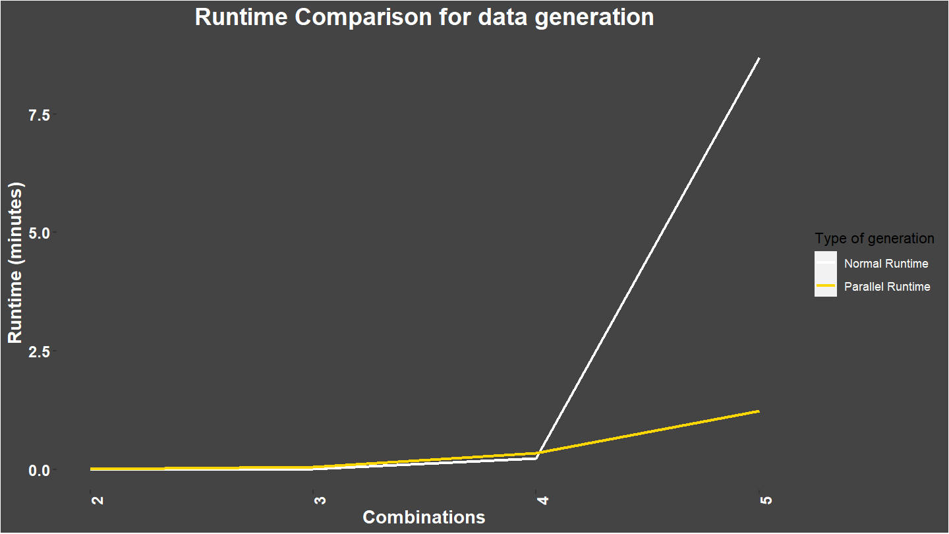
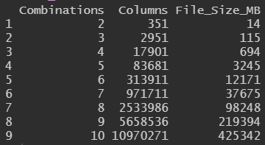
Data Data cleaning and data preparation (2/2)
Notes:
Our cleaning and preparation of the data required several key steps. These steps entailed:
aligning dates across different data frames to ensure uniformity;
sorting and filtering data to ensure uniformity;
revising column names for better comprehension;
recalculating inflation values into percentages for computational ease;
removing columns (indices) that did not contain sufficiently long dated price data and were not essential to creating the most relevant combinations of indices;
removing rows (dates) that contained N/A values, which reduced the length of the time series for each column (index) to the length of the time series of the remaining column that contains the least long dated price data.
To enhance the efficiency of our data cleaning process, we employed the dplyr library's powerful data manipulation functions and used purrr's map functions to implement changes across multiple dataframes.
In this way, we ensured that the data is clean, consistent, and ready for analysis, setting a strong foundation for our research into optimal, quantitative investment strategies. Notice that we reduced the number of columns (indices) from 49 to 26, which streamlines the process of calculating possible combinations between columns (indices), and we limited the number of rows (dates) to include only the observations for which each remaining column (index) contains available values.
The transformed data frames that were generated from the ones introduced in the section above ("swiss_inflation", "CHF_rf_rates", "CHF_FX" and "index_prices_local_currencies") include:
"index_prices_CHF": daily price data of selected indices, denoted in CHF (calculated through simple multiplication of prices with the relevant FX rate);
"return_series_CHF_nominal": daily nominal daily return series of selected indices, denoted in CHF (calculated from daily price data of selected indices in CHF)
"return_series_CHF_real": daily real daily return series of selected indices, denoted in CHF (calculated as the difference between daily nominal daily return series of selected indices and deannualized Swiss inflation)
“return_series_CHF_excess": daily excess daily return series of selected indices, denoted in CHF (calculated as the difference between daily nominal daily return series of selected indices and deannualized risk-free rates)

Slide 13
Coming up...
Background
Introduction
Research question
Data
Analysis
Results
Scaling & Cloud Deployment

Slide 14
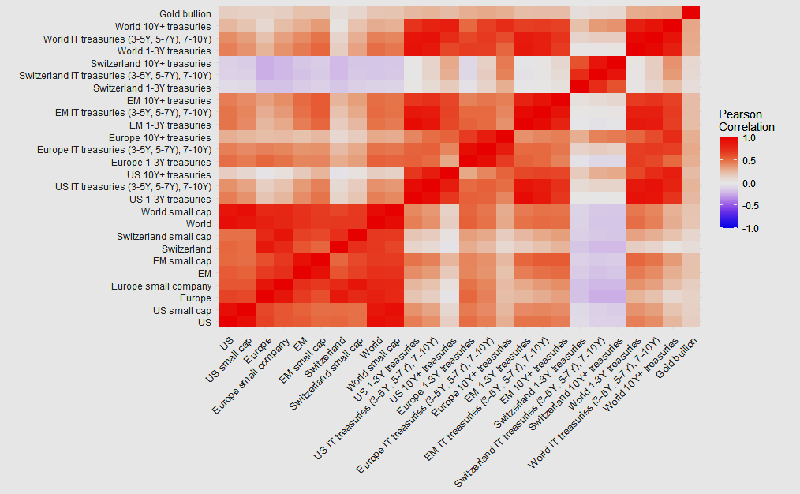
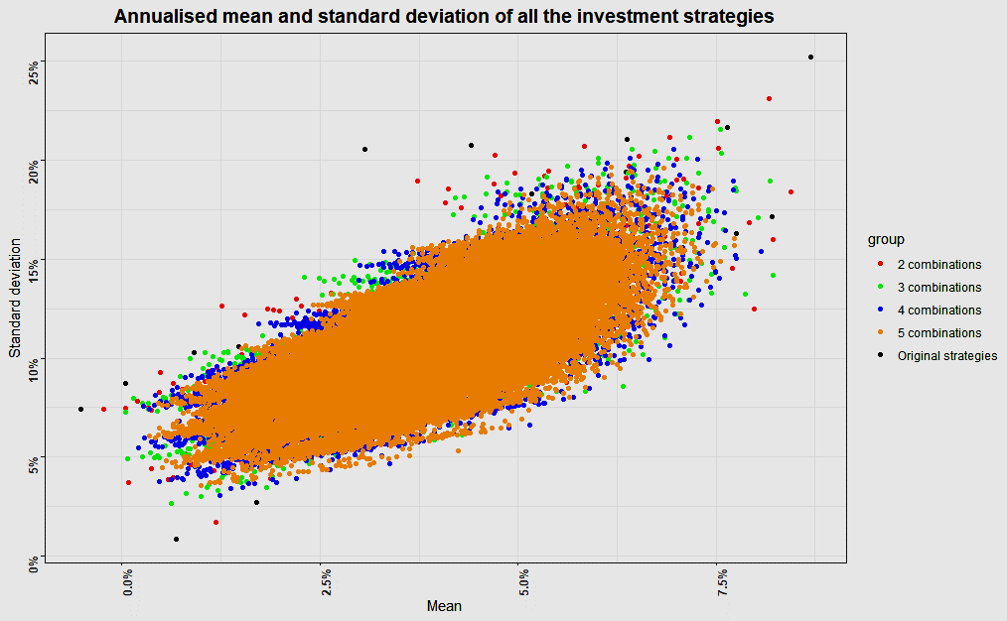
Analysis
Notes:
Our cleaning and preparation of the data required several key steps. These steps entailed:
aligning dates across different data frames to ensure uniformity;
sorting and filtering data to ensure uniformity;
revising column names for better comprehension;
recalculating inflation values into percentages for computational ease;
removing columns (indices) that did not contain sufficiently long dated price data and were not essential to creating the most relevant combinations of indices;
removing rows (dates) that contained N/A values, which reduced the length of the time series for each column (index) to the length of the time series of the remaining column that contains the least long dated price data.
To enhance the efficiency of our data cleaning process, we employed the dplyr library's powerful data manipulation functions and used purrr's map functions to implement changes across multiple dataframes.
In this way, we ensured that the data is clean, consistent, and ready for analysis, setting a strong foundation for our research into optimal, quantitative investment strategies. Notice that we reduced the number of columns (indices) from 49 to 26, which streamlines the process of calculating possible combinations between columns (indices), and we limited the number of rows (dates) to include only the observations for which each remaining column (index) contains available values.
The transformed data frames that were generated from the ones introduced in the section above ("swiss_inflation", "CHF_rf_rates", "CHF_FX" and "index_prices_local_currencies") include:
"index_prices_CHF": daily price data of selected indices, denoted in CHF (calculated through simple multiplication of prices with the relevant FX rate);
"return_series_CHF_nominal": daily nominal daily return series of selected indices, denoted in CHF (calculated from daily price data of selected indices in CHF)
"return_series_CHF_real": daily real daily return series of selected indices, denoted in CHF (calculated as the difference between daily nominal daily return series of selected indices and deannualized Swiss inflation)
“return_series_CHF_excess": daily excess daily return series of selected indices, denoted in CHF (calculated as the difference between daily nominal daily return series of selected indices and deannualized risk-free rates)

Slide 15
Coming up...
Background
Introduction
Research question
Data
Analysis
Results
Scaling & Cloud Deployment

Slide 16
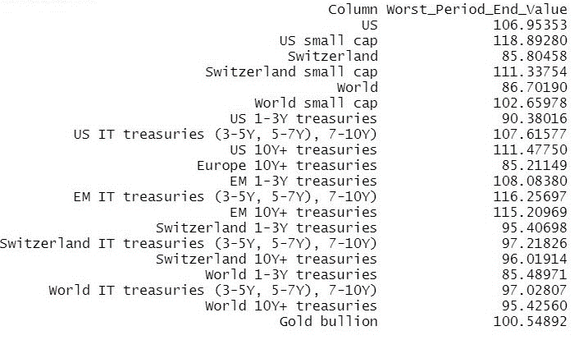
Results Example use case
Input parameters: 10 year time period 85% threshold Best of the worst-cases: US small cap
Notes:
Our cleaning and preparation of the data required several key steps. These steps entailed:
aligning dates across different data frames to ensure uniformity;
sorting and filtering data to ensure uniformity;
revising column names for better comprehension;
recalculating inflation values into percentages for computational ease;
removing columns (indices) that did not contain sufficiently long dated price data and were not essential to creating the most relevant combinations of indices;
removing rows (dates) that contained N/A values, which reduced the length of the time series for each column (index) to the length of the time series of the remaining column that contains the least long dated price data.
To enhance the efficiency of our data cleaning process, we employed the dplyr library's powerful data manipulation functions and used purrr's map functions to implement changes across multiple dataframes.
In this way, we ensured that the data is clean, consistent, and ready for analysis, setting a strong foundation for our research into optimal, quantitative investment strategies. Notice that we reduced the number of columns (indices) from 49 to 26, which streamlines the process of calculating possible combinations between columns (indices), and we limited the number of rows (dates) to include only the observations for which each remaining column (index) contains available values.
The transformed data frames that were generated from the ones introduced in the section above ("swiss_inflation", "CHF_rf_rates", "CHF_FX" and "index_prices_local_currencies") include:
"index_prices_CHF": daily price data of selected indices, denoted in CHF (calculated through simple multiplication of prices with the relevant FX rate);
"return_series_CHF_nominal": daily nominal daily return series of selected indices, denoted in CHF (calculated from daily price data of selected indices in CHF)
"return_series_CHF_real": daily real daily return series of selected indices, denoted in CHF (calculated as the difference between daily nominal daily return series of selected indices and deannualized Swiss inflation)
“return_series_CHF_excess": daily excess daily return series of selected indices, denoted in CHF (calculated as the difference between daily nominal daily return series of selected indices and deannualized risk-free rates)

Slide 17
Coming up...
Background
Introduction
Research question
Data
Analysis
Results
Scaling & Cloud Deployment

Slide 18

Scaling and Cloud Deployment (Work in progress)
Leveraging the power of cloud platforms and data processing technologies: 1. Employ better (machine learning) algorithms for our investment optimization model. 2. Evaluate and improve the out-of-sample performance of our model. 3. Improve computational performance. 4. Store increasingly large data sets more efficiently.
Functionality | Amazon AWS | Google Cloud Platform | Microsoft Azure | Open-Source Software
Object Storage | Amazon S3 | Google Cloud Storage | Azure Blob Storage | Hadoop Distributed File System (HDFS)
Data Warehousing / Analysis | Amazon Redshift | BigQuery | Azure Databricks | Apache Hadoop (MapReduce), Apache Spark (Spark SQL)
Compute Instances | AWS EC2 | Google Compute Engine | Azure Virtual Machines | -
Machine Learning Platform | AWS SageMaker | Google Colab, Google Cloud AI | Azure Machine Learning | Apache Spark (Spark MLlib), H2O.ai, TensorFlow, PyTorch
Database Management System | Amazon RDS | Google Cloud SQL | Azure SQL Database | SQLite
Data Orchestration | AWS Step Functions | Google Cloud Composer | Azure Logic Apps | Apache Airflow
Notes:
To ensure computational efficiency and scalability, we adopted strategies for big data analytics and cloud deployment,
1. Identifying the most optimal machine learning algorithms, and the reasoning behind these choices
2. If our optimisation algorithm runs fast enough on this dataset with cloud computing then we can expand our data generation to include combinations of up to 6 or 7 with sparkR.
3. evaluating the out-of-sample performance of such strategies.
4. much larger data frames which were immediately stored in a more efficient manner (how?)

Slide 19

Thank you! Questions?

